Slide 1
Choosing the right database for your product
Database vs.
Data warehouse vs.
Datalake
Notes:
Technology democratization has led to make available the best features to be available in almost all products in a line. Even in same cloud provider here lets say Azure, different products in Data Analytics look alike when we just look at the features on top. In this session, let me share my learnings, how we analysed different frameworks for our use case and chosen the right tech to solve our requirement. I hope it would help folks who are watching this to setup the best data architecture by choosing right tools .

Slide 2





About Me
Dinesh Kumar P
Product Manager, Analytics Squad,
Volunteer,
Notes:
Myself currently working as a product manager, for the analytics and reports squad at Kissflow. Coming through 8+ years of the journey around data space, I have involved in implementing B2B SaaS products for Big Data, ETL, and Business Intelligence.

Slide 3

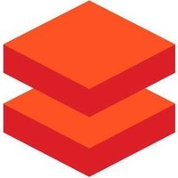
Agenda
1. Core architecture and scenarios of having Database, Data warehouse, Data Lake.
2. Azure Synapse Analytics, Azure Databricks.
3. Common features but different in Synapse and Databricks of Azure.
4. When to use Azure Synapse, Azure Databricks?
5. Cloud data warehouse era.
6. Snowflake on Azure.
7. Data use cases at
8. What’s next? Data Lakehouse.
Notes:
Wont be covering about each topic in detail. The aim of my talk is to share my knowledge about understanding the difference between tech stack, which look almost same in terms of features. And I expect that audience would know a little bit of basics like what is a Database, Data warehouse and so.

Slide 4

For what basic skill, different people get different salaries?
$10,000
$5000
$1000
$500
$50
Notes:
Let me ask a simple question. For what basic skill, different people get different salary? Perhaps that is the same basic thing which all the ML or AI projects are solving and make our life easier.

Slide 5
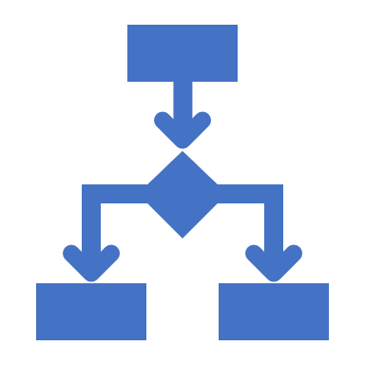


Decision Making
Notes:
Its DECISION MAKING.

Slide 6
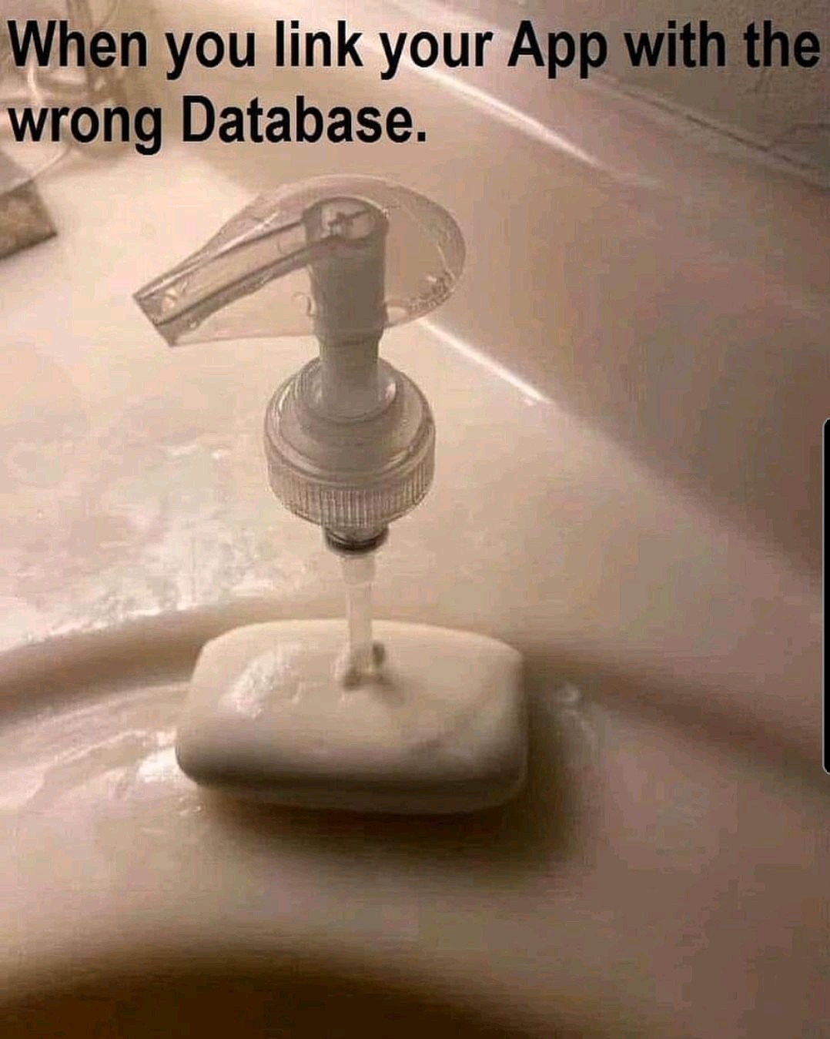
Before beginning…
* Don’t choose a data tech, just because you / your team knew it.
* Lets see how to choose right database for your need.

Slide 7
Database Data warehouse Data Lake
- Demystify.
- Best fit scenarios to choose.
Notes:
This is a crazy and slightly confusing time in the data architecture space. More and more companies are shifting towards data lakes, yet the traditional data warehouse and database continues to provide value, as it has for decades. Now to add that, we have this increasingly popular lakehouse and delta lake concept. The concepts I discuss here will be common that would fit for deciding over data services in Azure as well.

Slide 8
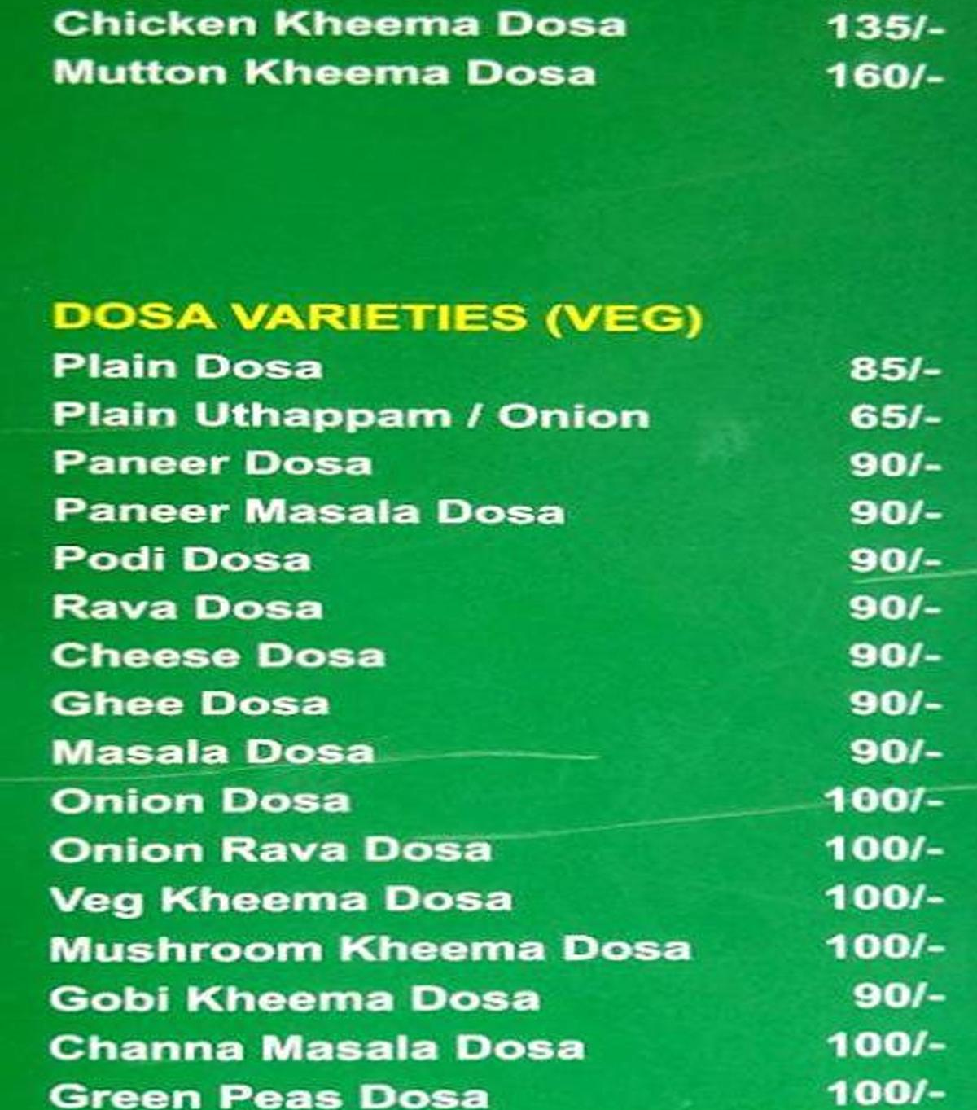
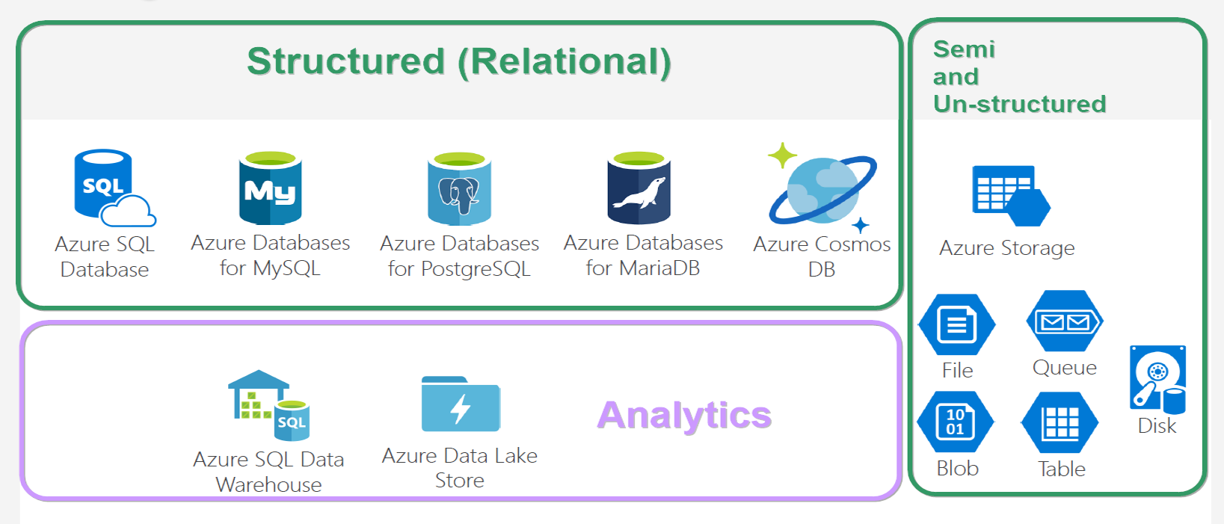
Database VARIETIES
Notes:
And looking at this, does both give same feeling? ☺

Slide 9
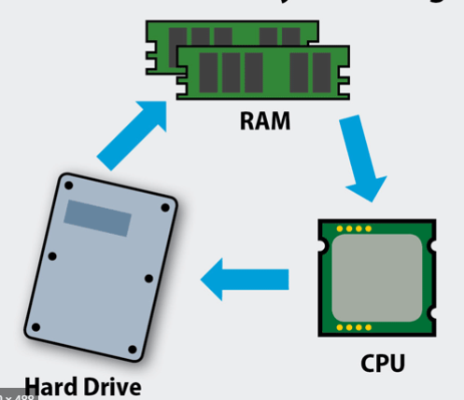
Database
* Co-location of Compute & Storage.
* Schema on Write.
* Recommended for,
- Structured data of less than a TB,
- Main purpose - OLTP.
* Not recommended for,
- Ad-hoc analytics.
- Data scale beyond 1 TB quickly.

Slide 10
DBMS storage models
Notes:
NoSQL db – data storage model types –
* Document - Frequent schema changes with sub-tables need. The document model allows you to structure data any way your application needs (Mongo DB)
* Graph – Neo4j.
* Key-value - Redis.
* Column-oriented – Hbase, Cassandra.

Slide 11
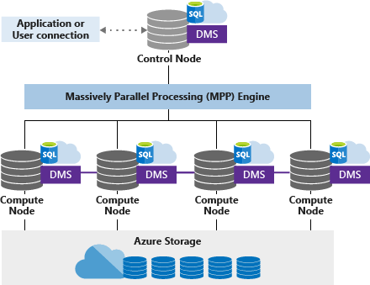
Data warehouse
* Separation of Compute & Storage. (Data copied into warehouse).
* Schema on Write.
* Recommended,
- If you know metadata & format of analytics to be done.
- ML/AI not needed much. Query not over large dataset.
- Expose out; allowing customers to analyse.
* Not recommended,
- Unstructured data like image and video.
- Semi-structured with multiple levels.

Slide 12
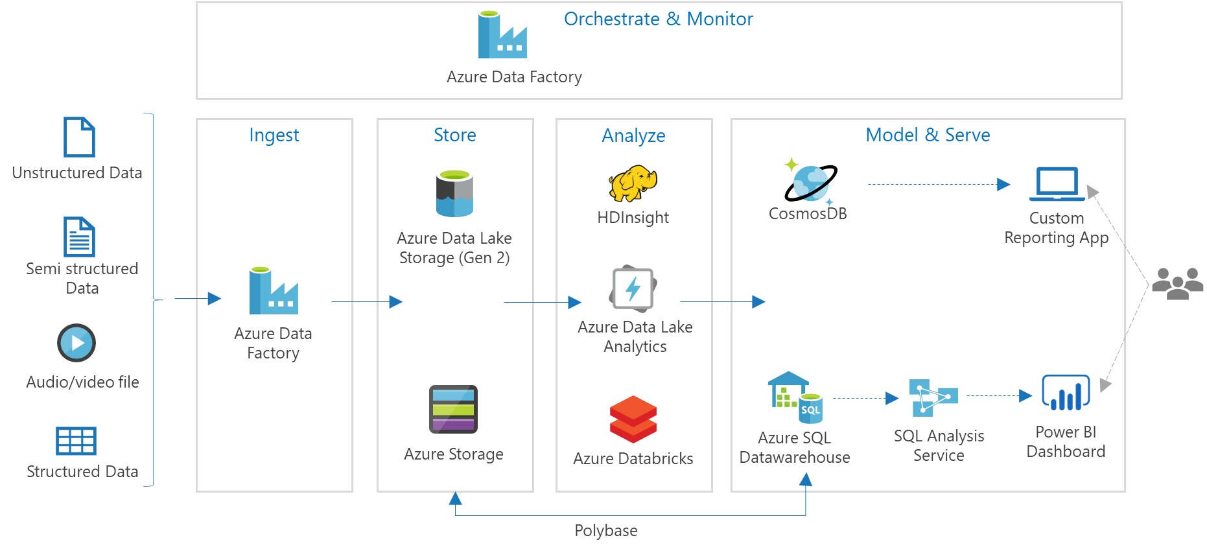
Data lake
* Separation of Compute & Data.
* Schema on Read.
* Recommended,
- Must store all types of data of any size.
- Query over large datasets.
- Store now; play later as and when you need. (Internal analytics).
* Not recommended,
- Data stored should be readily available for analytics upon which users would create reports.

Slide 13
Things to consider while choosing
1. Type of data (Structured/Semi/Un)
2. Who is using the data. (Internal or External) (Data scientist / business users)
3. Technology – Open source / Cloud provider agnostic.

Slide 14
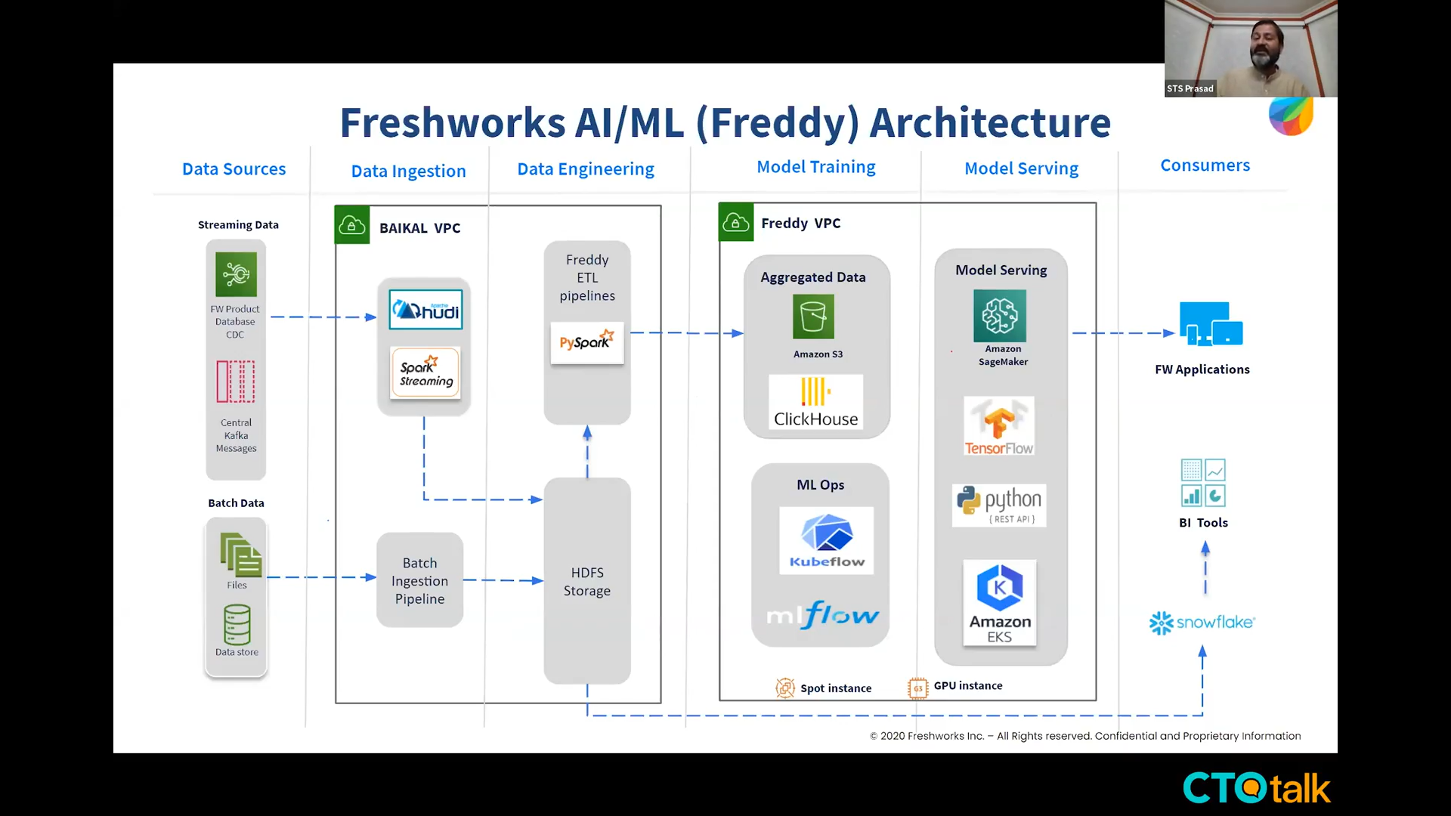
HYBRID Data architecture
Notes:
https://blog.ctotalk.in/freddy-and-the-analytics-platform-of-freshworks-by-sts-prasad-svp-freshworks-engineering-in-cto-2fbaefc204e3

Slide 15
OLTP vs OLAP
Transaction databases
Analytics databases

Slide 16
transaction db vs analytics db
Characteristic | OLTP | OLAP
Data | Operational data in row format. Both read and write – CRUD. | Historical data in column format. More Read and less rare – SELECT.
Query pattern | Small no of records fetched by a key, Simple joins. | Large no of records with aggregation columns. Complex joins with where clauses.
Users | Application developers. | Analyst, decision makers.
Providers | SQL Server, Mysql, Postgres. Azure Cloud SQL, Google Cloud Spanner, AWS RDS. | Teradata, Vertica. Synapse Analytics, Snowflake, Big Query, Redshift.

Slide 17
Use case at Kissflow

Slide 18
* SaaS product - No Code environment.
* Customers (business users) build workflow apps for their domain.
* Based on our product nature, per customer data won’t be huge.
* OLTP – MongoDB (Earlier MySQL)
* 1 database per customer. Unique schema (data model) for each customer.
* OLAP - explored data lake, database and finally we choose data warehouse.
Notes:
Kissflow Digital Workplace is a no-code environment where anyone can create an automated process, build a project board, handle a case flow, and host important discussions about work, all in one intelligent and easily integrated platform.
In a nutshell Digital Workplace Platform will be having operational records, where each record is a proof of transaction happening in an organization.

Slide 19
OLTP => SQL to NO-SQL
* MySQL to MongoDB.
* Scalability. (Vertical vs Horizontal)
* Flexible schema.
* Document/MongoDB specific advantages – Embedded documents, Sharding.
* Query performance beyond 1 TB.
* Dedicated server instance/customer to single HA cluster Master-Slave architecture.
* It was fine Kissflow at initial stage with one main product. Migrated to NoSQL architecture to scale into multiple product model.

Slide 20
Demo – 1
Workflows.
Scenario when a NoSQL database is a better choice for the product.

Slide 21
OLAP
2 Categories:
1. Curate own data and find insights. E.g Amazon.com, Uber.
2. Include analytics as a platform within the product. E.g. Kissflow, Freshworks.
Notes:
Organizations derive business value as insights either from their own data or allow their customers to derive value from their data by themselves. 2 categories of analytics - a. Include as part of product. (External outside the company - Kissflow, Freshworks) 2. For analysing and deriving metrics. (Internal within the company - Khatabook)

Slide 22
CLOUD data warehouse ERA
Azure Synapse Analytics
Snowflake
Amazon Redshift
Google BigQuery

Slide 23

Notes:
Always choose by use case.

Slide 24
Azure Synapse Analytics Azure Databricks
What is it?
Common features but how each one is different?

Slide 25
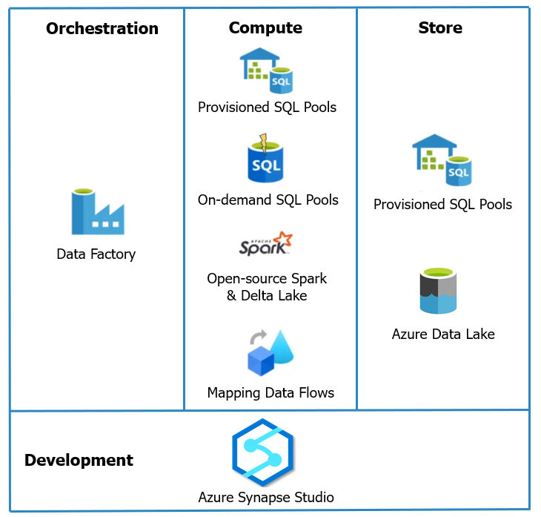
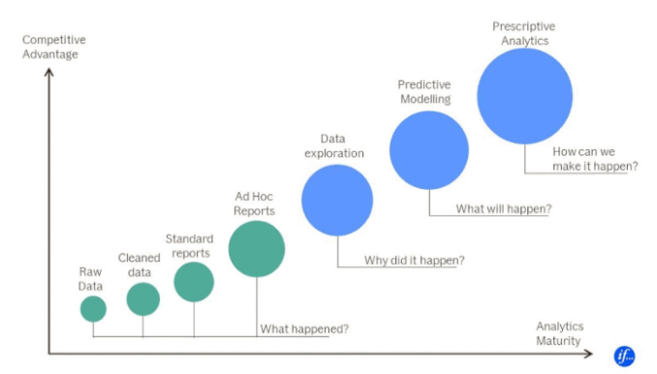
Azure Synapse Analytics
* Azure SQL Warehouse rebranded.

Slide 26
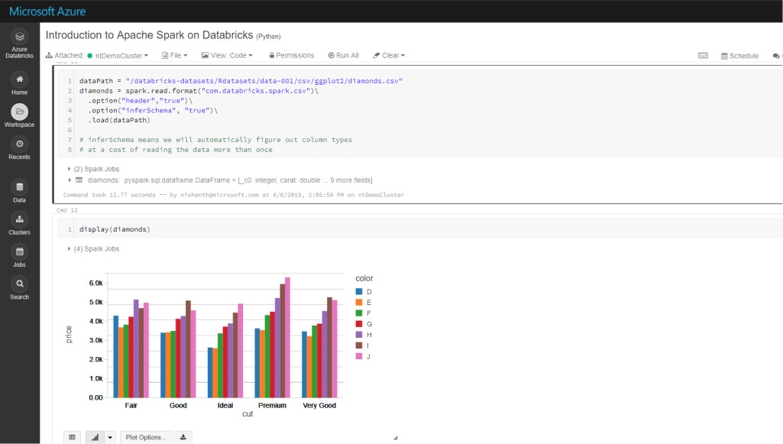
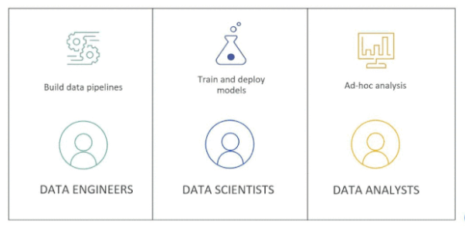
Azure databricks
* Data Lake.
* Hosted Spark environment - expanding with Delta Lake, MlFlow and SQL analytics.
* Best option for Machine Learning workloads for those with Microsoft tech stack.

Slide 27
Common but different
Common feature | Azure Synapse Analytics | Azure Databricks
Apache Spark & Delta Lake | Open-source. | Latest from Databricks.
Jupyter Notebooks | Nteract notebooks. | Databricks notebooks, real time co-authoring & automated versioning.
Access data from a Data Lake | Easier to query from sql scripts and notebooks. | Need to mount and then query.
Cloud hosted Python & SQL env | Good at Ad-hoc analysis. | Good at Mlflow.
Compute separate architecture | SQL on-demand pool. | Autoscaling pool.

Slide 28
When to use synapse and/or databricks
 | Use case / Scenario | Preferred
1 | Ad-hoc data lake discovery by code | Synapse and Databricks
2 | SQL analyses & Data warehousing | Synapse
3 | Self-service BI / Reporting | Synapse
4 | Same data, data scientists play via Spark & data analyst play via SQL. & BI use Power BI | Synapse
5 | More ML/AI development, GPU intensive tasks | Databricks
6 | Dependent tech is much on Delta lake format / Spark | Databricks
Notes:
Not going to repeat the points which I spoke earlier. I mean core features of Data warehouse / Data Lake / Data Lakehouse.

Slide 29
Demo 2 – Snowflake cloud data warehouse
OLAP
Analytics as a service

Slide 30
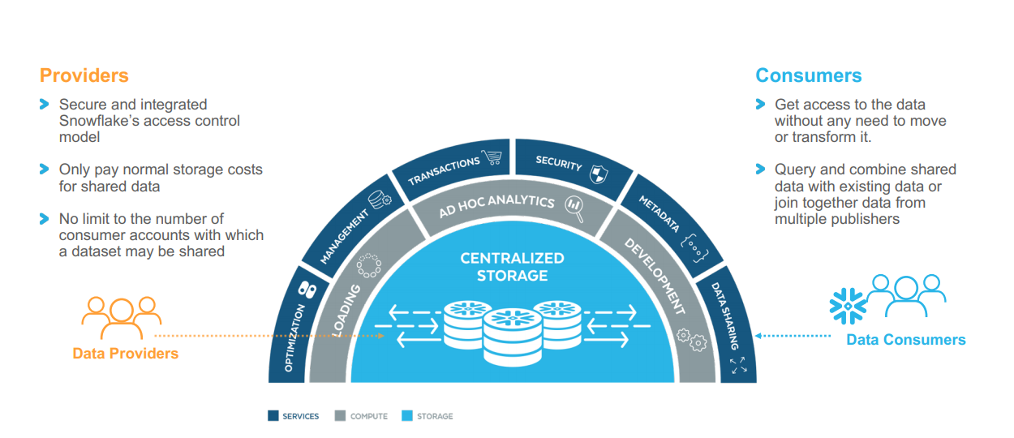
Snowflake ARCHITECTURE
Notes:
Store all your data.
Extreme simplicity.
Full support for ACID transactions with read consistency.
ANSI SQL, RBAC.

Slide 31
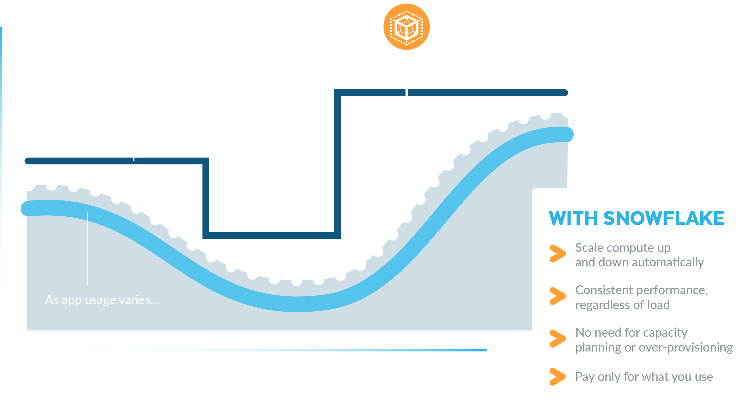
instant auto scaling

Slide 32
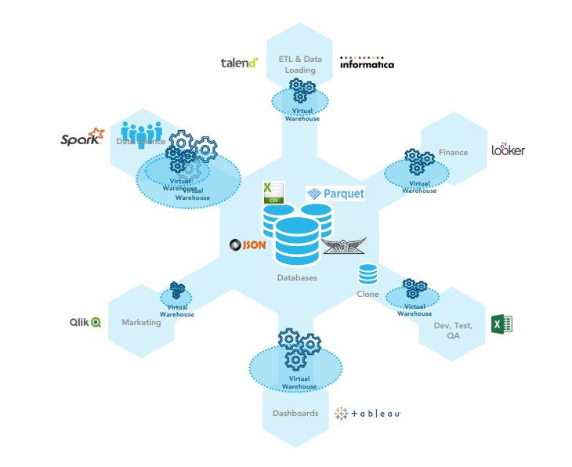
Multi-cluster shared data architecture

Slide 33
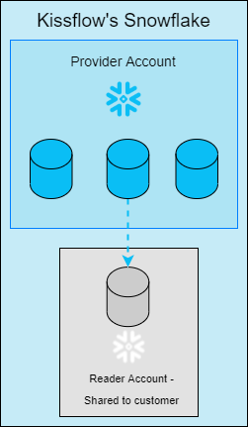
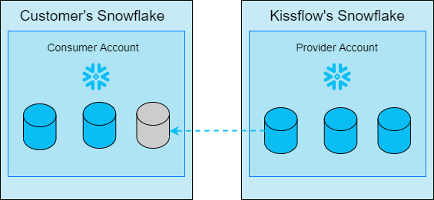
Data sharing to customers (external users)
READER ACCOUNT
FULL ACCOUNT

Slide 34
Demo – 2
Snowflake – Query semi-structured json data.
Power BI.
Notes:
AWS-Snowflake

Slide 35
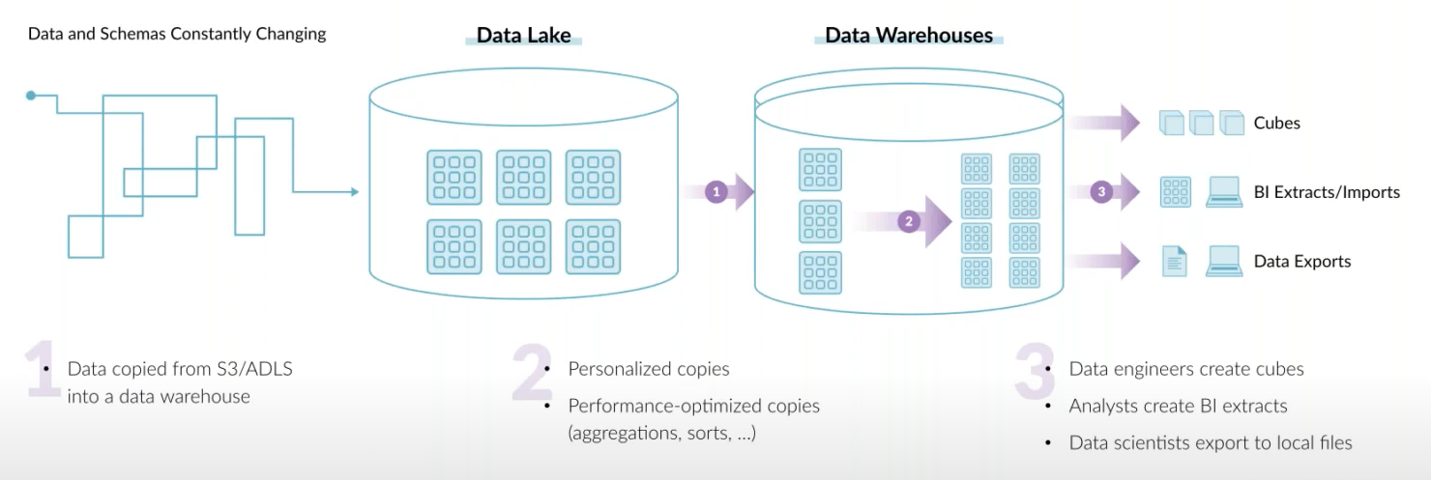
End goal of a data architecture
* Architect so that copying data gets lesser across teams.
* Choose (even its new) based on customers need, not based on what you or your team knows already.

Slide 36
WAIT, there’s more
Data Lakehouse
Delta lake

Slide 37
DATA LAKEHOUSE
* Sting together the best of both worlds – Data warehouse and Data lake.
* Implement data warehouse’ data structures & management features of data lakes.
* Single data lakehouse for structured, semi-structured and unstructured acts as a
=> Multi-solution system having single data store,
=> Simplified data governance,
=> Cost-effective too.
* Tools - Dremio, Databricks.

Slide 38
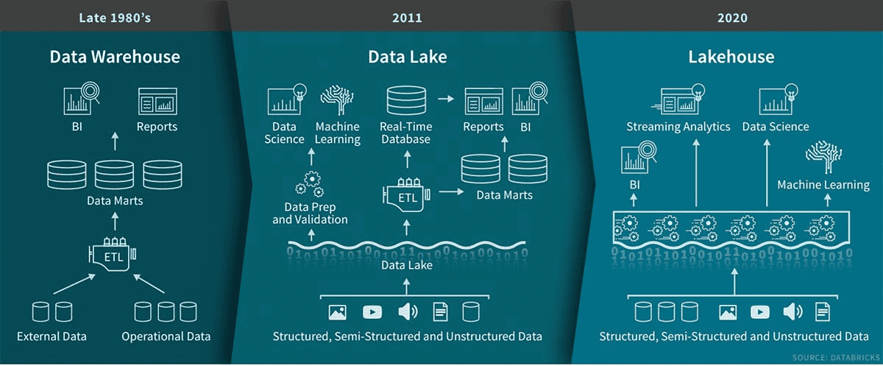
Data lakehouse

Slide 39
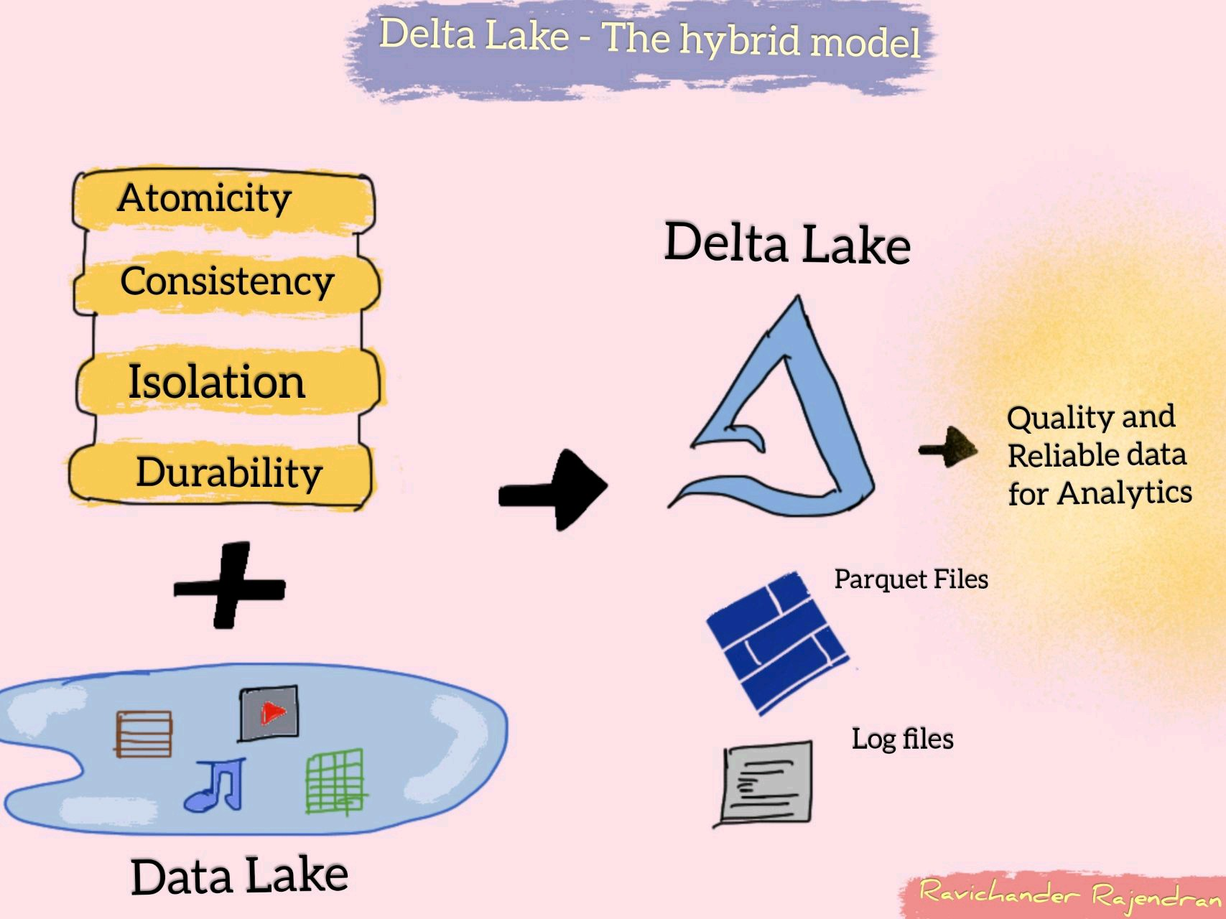
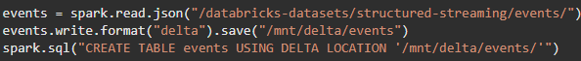
Delta lake – hybrid DATa format
Notes:
* Delta Lake that sits on top of data lake provides ACID transactions and unifies streaming and batch processing. It is also fully compatible with Spark APIs.
* In simple words, its about saving data as ‘Delta’ format and play with it.

Slide 40

So, what should you choose?
Notes:
Have your base as flexible as possible. Here the data format - make sure you have data availability in open source data format like ORC/Parquet.
Migrating from one data warehouse to another will be there to meet the demands of data consumers.

Slide 41
Resources to dive deep
* Post about “What is Data Lakehouse?”
* Blog post by Ivana Pejeva.
* Debate with proponents of each architecture at Datanova 2021 hosted by Cindi Howson.
* Blog - Launching Databricks at If by Valdas Maksimavicius.
* Video about choosing Data warehouse and/or Data lake.
Notes:
Data Lake vs. Warehouse: How to Choose the Right Solution for Your Stack | by Barr Moses | Towards Data Science

Slide 42
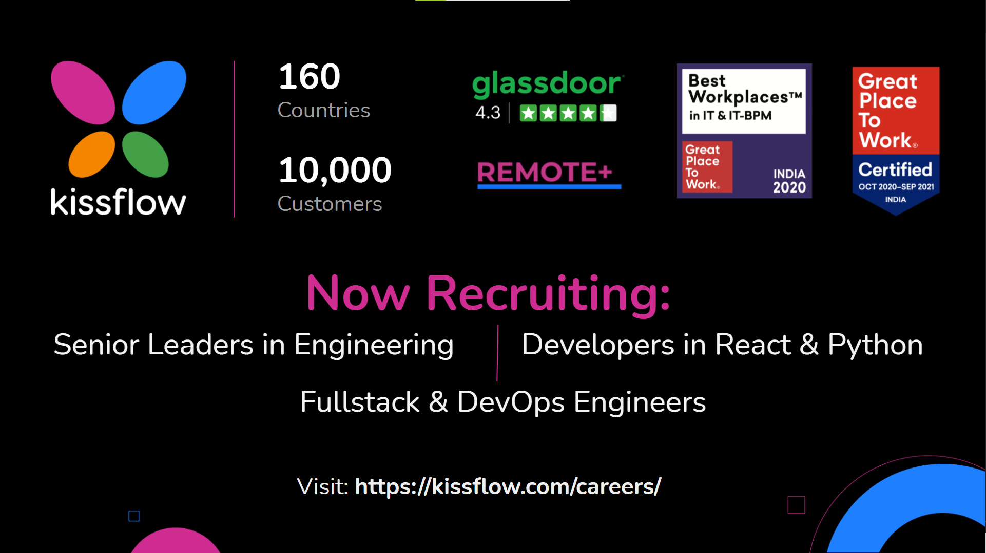

Slide 43

Questions ??
https://www.linkedin.com/in/dinesh-kumar-prabakaran

